Slide 1
Azure Times #90
October 11, 2023

Slide 2
Security & Identity

Slide 3
Security & Identity Updates
Public Preview - Device-bound passkeys as an authentication method
Beginning January 2024, Microsoft Entra ID will support device-bound passkeys stored on computers and mobile devices as an authentication method in preview, in addition to the existing support for FIDO2 security keys. This enables users to perform phishing-resistant authentication using the devices that they already have.
MS will expand the existing FIDO2 authentication methods policy and end user registration experience to support this preview release. If organization requires or prefers FIDO2 authentication using physical security keys only, then please enforce key restrictions to only allow security key models that accept in FIDO2 policy. Otherwise, the new preview capabilities enable users to register for device-bound passkeys stored on Windows, macOS, iOS, and Android.
Entra ID Protection policies deprecation
User risk policy or Sign-in risk policy in Entra ID Protection (formerly Identity Protection) is going to be deprecated on October 1, 2026. MS asked to migrate them to Conditional Access following.
Configuring Sign-in risk and User risk policies in Conditional Access provides these benefits:
Manage all access policies in one place.
Report-only mode and Graph API support.
Greater flexibility by combining risk conditions with other conditions like location for granular access control.
Enhanced security with multiple risk-based policies targeting different user groups or risk levels.
Improved diagnostics experience by viewing which risk-based policy applied in Sign-in Logs.

Slide 4
Security & Identity Updates
Updated retirement date for managing authentication methods in legacy Multifactor Authentication (MFA) & Self-Service Password Reset (SSPR) policies
The retirement of the legacy MFA and SSPR policies pushed back to September 30, 2025
Organizations should migrate their methods to the converged authentication methods policy where methods can be managed centrally for all authentication scenarios including passwordless, multi-factor authentication and self-service password reset.
Legacy MFA policy: Security > Multifactor authentication > Additional cloud-based multifactor authentication settings
Self-service password reset (SSPR): Password reset > Authentication methods
There is a three steps migration approach:
Limitations:
Security questions can only be enabled today by using the legacy SSPR policy.
Registration of FIDO2 security keys may fail for some users if the FIDO2 Authentication method policy is targeted for a group and the overall Authentication methods policy has more than 20 groups configured.
Registration campaign improvements
MS allows now users to skip the prompt a maximum of three times, after which they will have to go through the registration flow.
Entra ID tenants that are Microsoft managed, are going to enabling the feature for users that are fully dependent on PSTN methods (SMS and voice) today for their MFA.
General Availability - Support for Microsoft admin portals in Conditional Access
Azure portal
Exchange admin center
Microsoft 365 admin center
Microsoft 365 Defender portal
Microsoft Entra admin center
Microsoft Intune admin center
Microsoft Purview compliance portal
Pre-migration | The Authentication methods policy is used only for authentication. Legacy policy settings are respected.
Migration in Progress | The Authentication methods policy is used for authentication and SSPR. Legacy policy settings are respected.
Migration Complete | Only the Authentication methods policy is used for authentication and SSPR. Legacy policy settings are ignored.

Slide 5
Security & Identity Updates
Optimized MFA OTP delivery via WhatsApp
Entra ID (Azure AD) MFA supports delivering one-time passcodes (OTPs) via text message. These texts get sent to the default messaging app on a user's phone depending on the phone's operating system. In many countries though, these default apps aren't users' primary messaging apps. To help deliver OTPs to users on their preferred messaging platforms, Entra ID will roll out OTP delivery to WhatsApp in select regions.
Starting mid-September 2023, users in India, Indonesia, and New Zealand may start receiving MFA text messages via WhatsApp. Users that fit the following criteria are subject, but not guaranteed, to receive the updated experience:
Enabled for text messages / SMS as an authentication method
Already use WhatsApp
Have a phone number with a country code in one of the listed countries
Organizations with users in the listed countries that don't want their users to receive MFA text messages through WhatsApp will need to disable text messages as an authentication method in their tenant(s).
General Availability - Recovery of deleted application and service principals is now available
With this release, it is now possible to recover applications along with their original service principals, eliminating the need for extensive reconfiguration and code changes. It significantly improves the application recovery story and addresses a long-standing customer need. This change is beneficial:
Faster Recovery
Cost Savings
Preserved Data
Improved User Experience
The deleted applications are available for restore within the 30 days. It is also possible t o permanently delete the application.

Slide 6
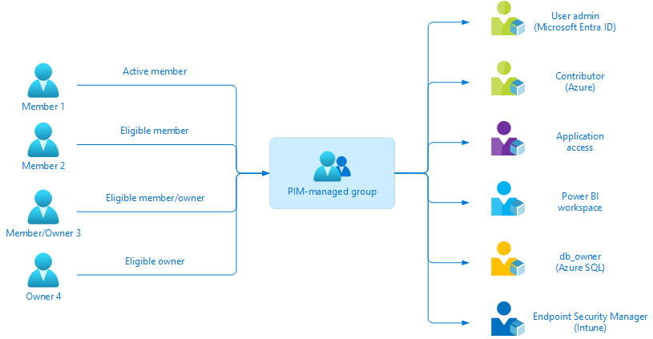
Security & Identity Updates
Just-in-time access to privileged roles with PIM for groups is GA
With the just-in-time group membership capability, it is possible to further simplify least privilege access by enabling just-in-time access for all resources that support security group or Microsoft 365 group assignments. This includes support for a wide range of roles such as Microsoft Entra roles, Azure resource roles, Microsoft Intune and non-Microsoft application roles and services. IT admins, developers, and security experts can now activate group membership once and have access to all defined resources precisely when needed to do their job.
PIM for Groups supports:
Just-in-time group membership and ownership. Members get access to various resources through the group membership, while owners can manage group properties such as membership.
Role-assignable and non-role-assignable groups, which removed the previous limit of 500 groups managed in PIM.
Security and Microsoft 365 group types.
Microsoft Entra ID P2 is required

Slide 7
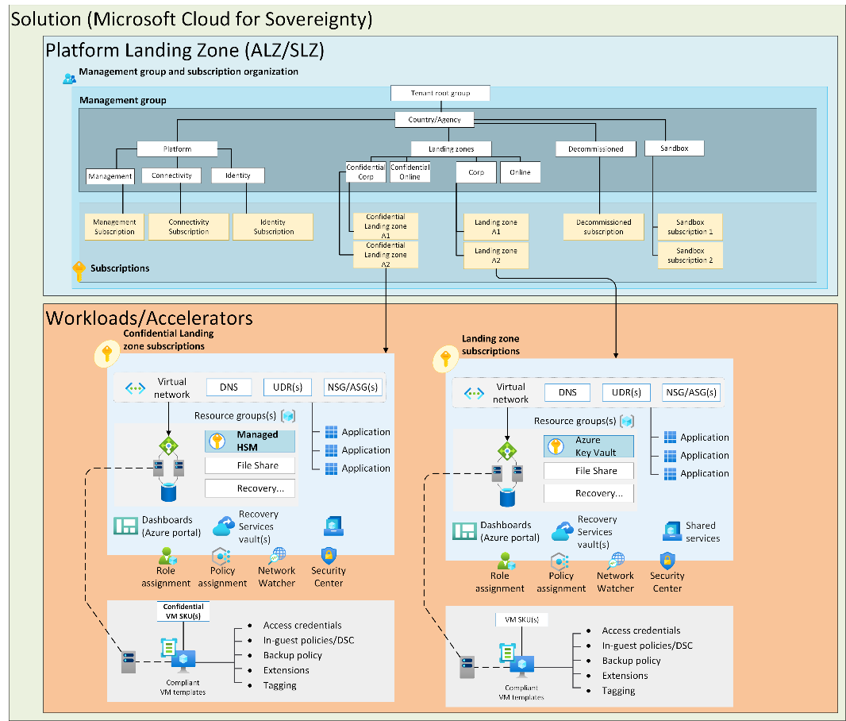
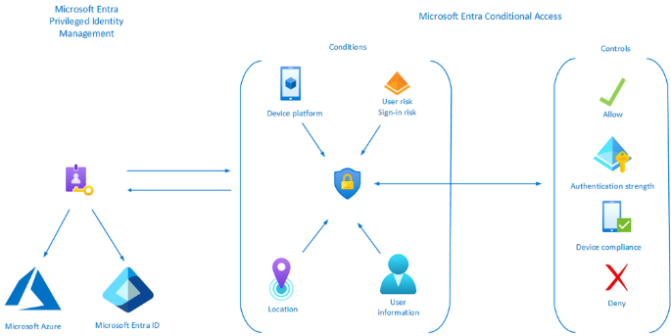
Security & Identity Updates
Enforce security requirements for activation using PIM integration with Conditional Access
Conditional Access authentication context allows to apply granular policies to sensitive data and actions, going beyond app-level policies. By combining PIM with Conditional Access, It is possible to enforce specific requirements for PIM role activations, enhancing security posture. During public preview, customers have leveraged this integration for various scenarios, such as:
Requiring strong modern authentication methods, using Conditional Access Authentication Strengths.
Requiring a compliant device for role activation.
Validating the user’s location through GPS-based named locations.
Blocking activation for risky users using Microsoft Entra ID Protection.
Microsoft Cloud for Sovereignty – public preview

Slide 8
Management & Governance

Slide 9
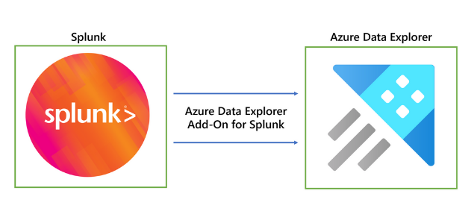
Management & Governance Updates
General availability: Microsoft Azure now available from new cloud region in Italy
MS launched our newest datacenter region in Italy. The Italy North datacenter region includes Azure Availability Zones, which offer additional resiliency for applications by designing the region with unique physical datacenter locations with independent power, network, and cooling for additional tolerance to datacenter failures.
For customers looking to leverage the new region and Availability Zones, Azure offers region portability for multiple resources with Azure Resource Mover.
Public Preview: Azure Data Explorer Add-On for Splunk
MS announced the public preview of Azure Data Explorer Add-On for Splunk.
Azure Data Explorer Add-on for Splunk allows users to effortlessly ingest data from Splunk to Azure Data Explorer.
This add-on uses kusto python sdk to send log data to Microsoft Azure Data Explorer. Hence, this addon supports queued mode of ingestion by default. This addon has a durable feature as well which helps to minimize data loss during any unexpected network error scenarios. Although durability in ingestion comes at the cost of throughput, therefore it is advised to use this option judiciously.

Slide 10
Management & Governance Updates
Generally available: Enhanced soft delete for Azure Backup
Enhanced soft delete for Azure Backup is now Generally Available. Enhanced soft delete provides an improvement to the soft delete capability in Azure Backup that enables to recover backup data in case of accidental or malicious deletion. With enhanced soft delete, you get the ability to make soft delete always-on and irreversible, thus protecting it from being disabled by any malicious actors. Hence, enhanced soft delete provides better protection for backups against various threats. This feature also allows to provide a customizable soft delete retention period for which soft deleted data must be retained.
Enhanced soft delete is now Generally Available for Recovery Services Vaults and Backup Vaults in all Azure Public regions.
Generally Available: Multi-user authorisation for Backup vaults
Multi-user authorisation (MUA) is now Generally Available for Backup vaults. MUA for Azure Backup adds an additional layer of protection for critical operations on Backup vaults, providing greater security for backups. To provide multi-user authorisation, Backup uses a resource guard to ensure critical operations are performed with proper authorisation, similar to how multi-user authorisation currently works for Recovery Services vaults.
The backup administrator, who typically owns the Backup vault, needs to gain the contributor role on the resource guard to be able to perform the protected operations. This requires action from the owner of the resource guard to approve and grant the required access. You can also use Azure Active Directory Privileged Identity Management to manage just-in-time access on the resource guard. Additionally, you can create the resource guard in a subscription or a tenant different from the one that has the recovery services vault, to achieve maximum isolation.

Slide 11
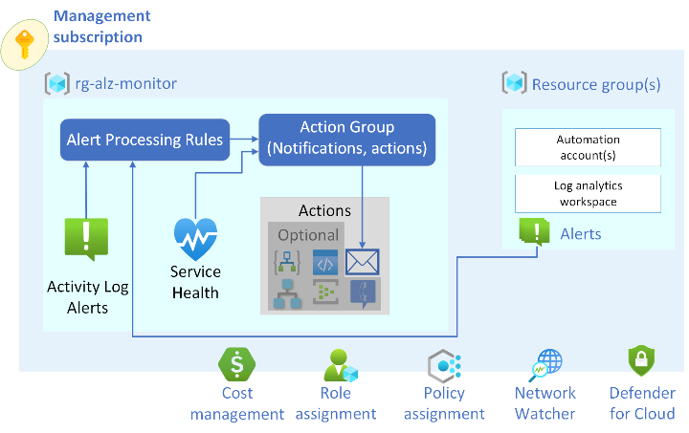
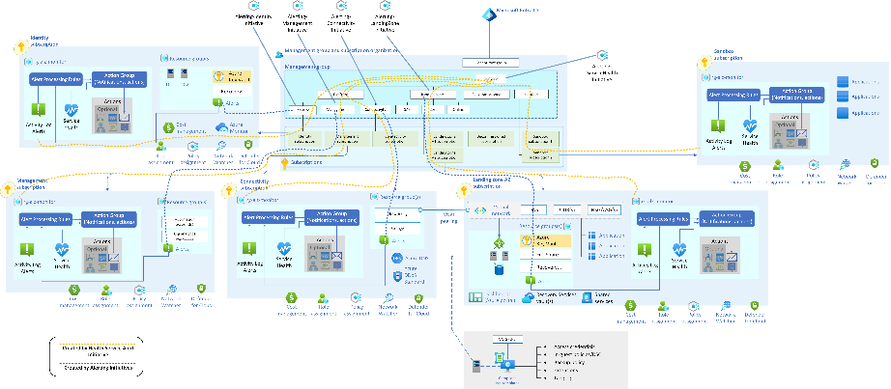
Management & Governance Updates
Azure Monitor Baseline Alerts (AMBA) for Azure landing zone (ALZ) is Generally Available (GA)!
Baseline metric, activity log, and log query alerts are available for landing zone platform components and other selected landing zone components. These alerts ensure consistent alerting and monitoring for your Azure landing zone. They're based on Microsoft-recommended practices for proactive monitoring, such as setting up alerts, thresholds, and notifications for timely problem detection and response. Use the following guidance to achieve real-time visibility into the performance, utilization, and security of your platform landing zone implementation. Proactively address issues, optimize resource allocation, and ensure a reliable and secure environment.
The following subsets of Azure components have one or more alerts defined:
Azure ExpressRoute
Azure Firewall
Azure Virtual Network
Azure Virtual WAN
Azure Monitor Log Analytics workspace
Azure Private DNS zone
Azure Key Vault
Azure Virtual Machine
Azure Storage account

Slide 12
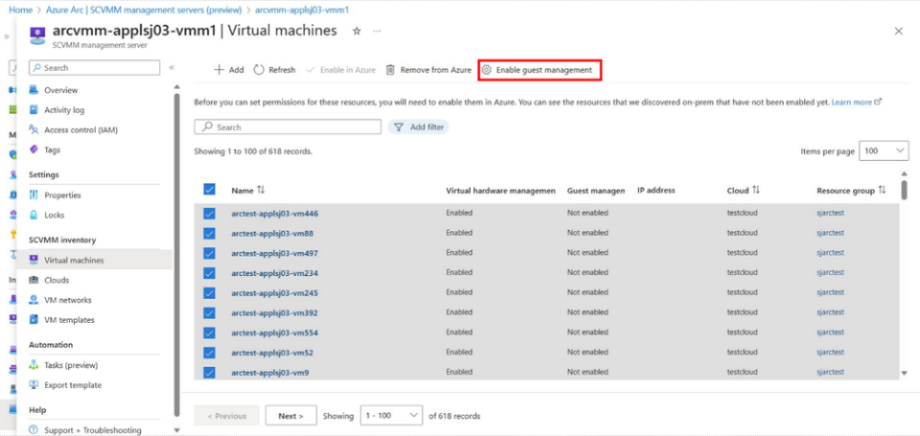
Management & Governance Updates
Azure management capabilities for Azure Arc-enabled SCVMM
MS announced additional capabilities for Arc-enabled SCVMM preview that is Azure management services support for Arc-enabled SCVMM VMs. Now it is possible to use Microsoft Defender for Cloud to secure their SCVMM VMs, use VM insights to monitor them through Azure Monitor, use Azure Update Manager to patch them and more.
All the Azure management capabilities that are available for Arc-enabled servers are now available for Arc-enabled SCVMM. With the ability to install Azure Arc agents at-scale directly from Azure, it is possible to accelerate and scale the adoption of Azure services for their entire System Center managed estate.

Slide 13
Compute

Slide 14
Compute Updates
Version 1.2.4675 of the Windows Desktop client for AVD has been released to Insiders!
What is changed:
Enhanced web to Microsoft Remote Desktop Client launch capabilities by adding multiple monitor configuration parameters to support internal and external customers.
Added support for the following languages: Czech (Czechia), Hungarian (Hungary), Indonesian (Indonesia), Korean (Korea), Portuguese (Portugal), Turkish (Turkey).
Fixed a bug that caused a crash when using Teams Media Optimization.
Improved client logging, diagnostics, and error classification to help admins troubleshoot connection and feed issues.
Azure Container Apps is now eligible for Azure savings plan for compute
Azure Container Apps is now eligible for Azure savings plan for compute! All Azure Container Apps regions and plans are eligible to receive 15% savings (1 year) and 17% savings (3 years) compared to pay-as-you-go when commit to an Azure savings plan.

Slide 15
Compute Updates
General Availability: Upgrade your existing Azure Gen2 VMs to Trusted Launch
Support for upgrade of existing Azure Generation 2 VMs to Trusted Launch is now generally available. It is possible to seamlessly enable Trusted Launch and improve the security of existing Azure Generation 2 VMs.
Enabling Trusted launch on existing virtual machines (VMs) is currently not supported for following scenarios:
Azure Generation 1 VMs is currently not supported.
Azure Virtual Machine Scale Sets (VMSS) Uniform & Flex are currently not supported.
To enable it the VM must meet the following requirements :
Configured with: Trusted launch supported size family and Trusted launch supported OS Image.
Azure Generation 2 VM(s) is not using features currently not supported with Trusted launch.
Azure Generation 2 VM(s) should be stopped and deallocated before enabling Trusted launch security type.
Azure Backup if enabled for Generation 2 VM(s) should be configured with Enhanced Backup Policy.
Features that are not supported by trusted launch:
Azure Site Recovery
Azure Automanage
Ultra disk
Managed Image
Nested Virtualization (most v5 VM size families supported)

Slide 16
Compute Updates
App Service: Backup and Restore over Azure Virtual Network
It is now possible to custom backups, to back up web app's files and configuration data to a firewall-protected storage account if the following requirements are fulfilled:
The app is integrated with a virtual network, or the app is in a v3 App Service environment.
The storage account has granted access from the virtual network that the app is integrated with, or that the v3 App Service environment is created with.

Slide 17
Storage & Data

Slide 18
Storage & Data Updates
Azure NetApp updates: Snapshot manageability enhancement: Identify parent snapshot
It is now possible to see the name of the snapshot used to create a new volume. In the Volume overview page, the Originated from field identifies the source snapshot used in volume creation. If the field is empty, no snapshot was used.
Public Preview: Customer-managed keys for Azure NetApp Files volume encryption is now available in US Gov regions (Preview)
Customer keys are protected from attacks for maximum security of their Azure NetApp File volumes using this feature. This capability is now available in US Gov Virginia and US Gov Texas (preview). This increased security complements the additional security for deployments in US Gov. Healthcare, Finance, Government, and many other customers can now protect their customer-managed encryption keys within the secure confines of US Gov regions.

Slide 19
Databases

Slide 20
Databases Updates
TDE with database-level CMK now generally available for Azure SQL Database
Azure SQL Database provides Transparent Data Encryption (TDE) to safeguard against offline threats by encrypting the data at rest. By using a Customer-Managed Key (CMK), TDE can further enhance data protection by enabling the use of a key stored in a customer owned and managed Azure Key Vault as the TDE Protector on the server. When TDE with CMK is set at the server level, all encrypted databases associated with the server inherit the same level of protection.
Generally Available: Add an Azure Cosmos DB custom endpoint in Azure IoT Hub
Azure IoT Hub now supports the ability to setup an Azure Cosmos DB account as a custom routing endpoint. This will help route device data from IoT Hub to Azure Cosmos DB directly. The feature also allows the configuration of Synthetic Partition Keys for writing data into Azure Cosmos DB which helps in optimized querying when working with large-scale data.

Slide 21
Miscellaneous

Slide 22
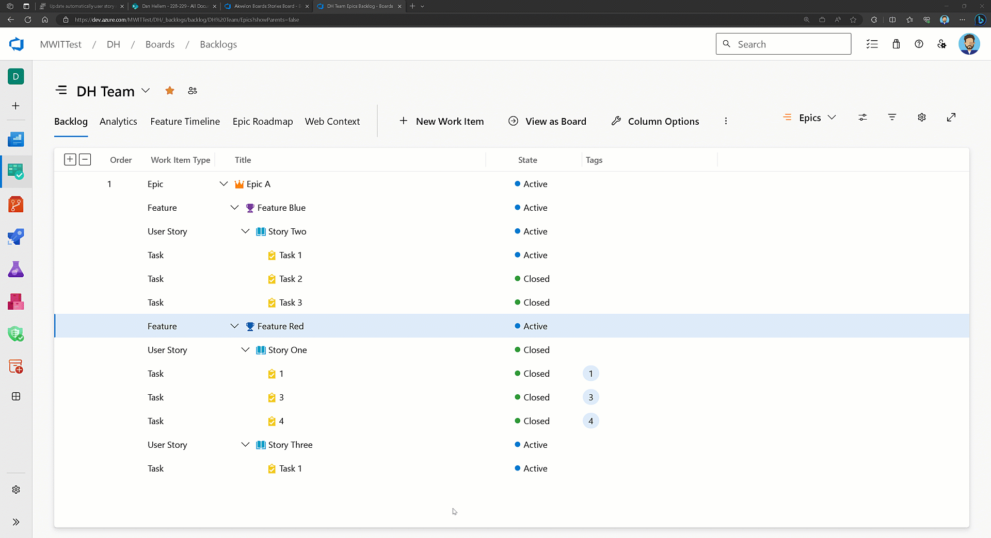
Miscellaneous Updates
Team Work Item Automation Rules (Private Preview)
MS released a private preview for:
Activating the parent item if at least one child was activated
Complete the parent item when all child items are completed
Public preview: Announcing Microsoft Playwright Testing service: Scalable end-to-end testing for modern web apps
MS announced the preview of Microsoft Playwright Testing, a new service for running Playwright tests easily at scale.
Playwright, a fast-growing, open-source framework, enables reliable end-to-end testing and automation for modern web apps.
Microsoft Playwright Testing service uses the cloud, enabling to simultaneously run Playwright tests with much higher parallelization across different operating system-browser combinations. This means faster testing and quicker troubleshooting, which helps speed up delivery of features without sacrificing quality.

Slide 23
Miscellaneous Updates
Introducing secret scanning validity checks for major cloud services
GitHub send a request with the tokens to validate if its valid or not.
Once the setting is enabled, it will be visible if the token is active or not. Platform performs checks periodically in the background, but it is also possible to conduct a manual refresh by clicking ‘Verify secret’ in the top right corner.
Introducing the new, Apple silicon powered M1 macOS larger runner for GitHub Actions
GitHub released a public beta for the new, Apple silicon powered M1 macOS larger runner for GitHub Actions.
Apple developers require the latest chipset to take advantage of features in the latest versions of iOS and macOS. They also want increased performance by leveraging the on-chip GPU capabilities of the M1 processor. The M1 macOS runner comes with GPU hardware acceleration enabled by default. Workloads are transferred from the CPU to the GPU for improved performance and efficiency. The runner is equipped with a 6-core CPU, 8-core GPU, 14 GB of RAM, and 14 GB of storage. It can reduce build times by up to 80% compared to the existing 3-core Intel standard runner, and up to 43% compared to the existing 12-core Intel runner.

Slide 24
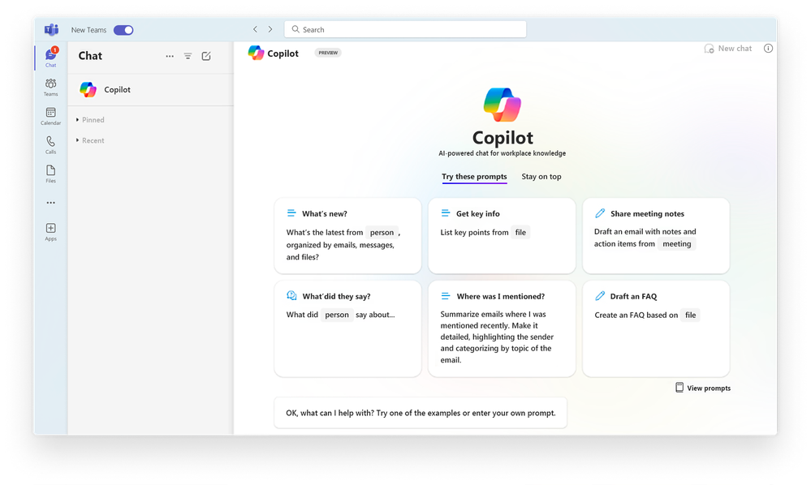
Miscellaneous Updates
Announcing general availability of the new Microsoft Teams app for Windows and Mac
The new version of new Teams is up to two times faster while using 50% less memory. New Teams now has full feature parity for almost all features including custom line-of-business apps, third-party apps, breakout rooms, 7x7 video, call queues, PSTN calling, contextual search in chats and channels, cross-post a channel conversation, and more.
New Teams includes support for Multi-tenant organizations (MTO) and multi-tenant, multi-account (MTMA), which enable seamless cross-tenant communication and collaboration beyond organizational boundaries across multiple tenants and accounts.
Upgrading to new Teams is quick and seamless -- no migration is required!
A faster app optimized for performance on multiple platforms
A simpler user experience that makes it easier to do more in fewer clicks

Slide 25
Retirement

Slide 26
Miscellaneous Updates
Retirement notice: Bing Speech will be retired on 3 November 2023 | Azure updates | Microsoft Azure
Azure Cosmos DB built-in Jupyter notebooks will be retired March 30, 2024 | Azure updates | Microsoft Azure
Azure Activity Logs Legacy solution is replaced by Diagnostic settings | Azure updates | Microsoft Azure
Some Azure Service Bus SDK libraries will be retired on 30 September 2026—migrate to the latest SDKs | Azure updates | Microsoft Azure
Migrate to Azure Monitor agent–based VM insights by 31 August 2024 | Azure updates | Microsoft Azure
Support for Azure Machine Learning Explanation and Fairness Dashboards is ending on 14 March 2025 | Azure updates | Microsoft Azure
Support for TLS 1.0/1.1 on Azure Cache for Redis ending on 30 September 2024 | Azure updates | Microsoft Azure
Migrate to Azure Resource Manager control plane API version 2021-11-01 by 30 September 2026 | Azure updates | Microsoft Azure

Slide 27
Information

Slide 28
Information
Azure Times GitHub Repo

Slide 29
Questions

